Slide 1
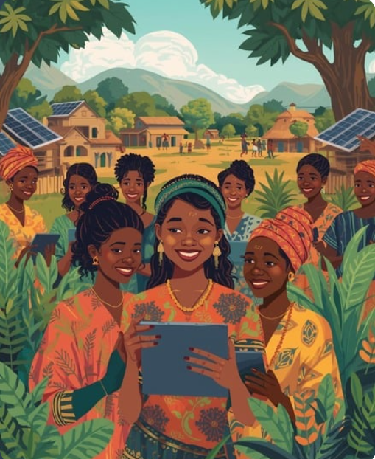

Siyakha Platform Presentation
Presented by Group 9

Slide 2
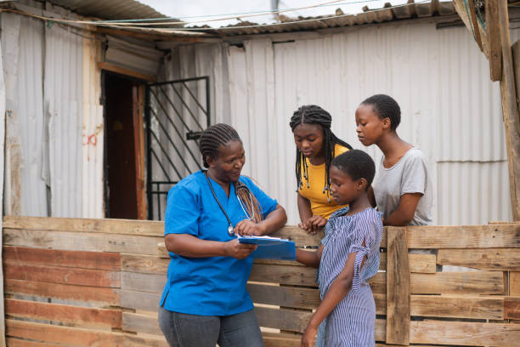
The Problem
“The Digital Divide is Leaving Entrepreneurial Women in Rural Areas Behind”
Limited digital access & literacy
Language barriers
Cultural & Societal Expectations
Lack of market access.
Poor connectivity

Slide 3
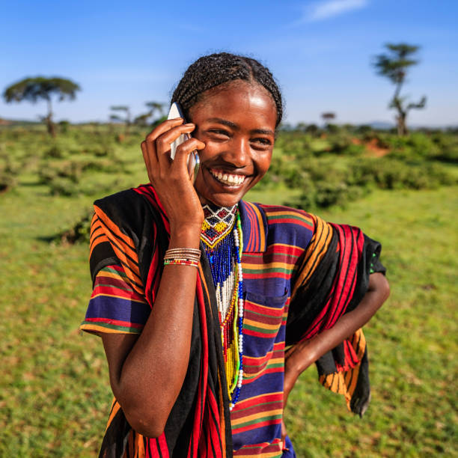
Our Point of View
Rural women desire to grow their businesses but lack the digital education and support needed in their native language. Empowering them with resources ensures they can connect with wider markets and thrive.

Slide 4
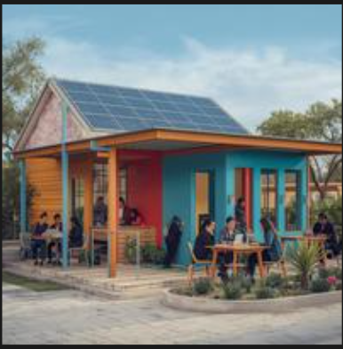
Learning, Building, Connecting
Integrated digital and physical solutions
Website
eCommerce Integration
Central Hub
Step by step tutorials and labs on web creation and fundamentals on e-commerce
Interactive micro-learning, videos, quizzes
Levels: Beginner, Intermediate, Advanced
Functioning websites will be pushed on our platform for visibility & traffic
Partnerships with Takealot, local municipalities, and PEP stores for logistics and visibility.
A physical internet-powered learning space (solar-powered).
Facilitated by women, for women.
Offers mentorship, access to devices, and local Wi-Fi towers for mobile access
4

Slide 5
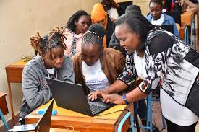

Implementation Plan
How We’ll Roll Out SIYAKHA
Pilot (6 months):
Launch hubs in EC & KZN, run workshops, gather feedback
Year 1 – Expansion:
Add 5 rural areas, launch app, local language support
Year 2 – Partnerships:
Collaborate with PEP, Takealot, municipalities, NGOs
Year 3 – Sustainability:
Ads & training fees, train women as local facilitators
5

Slide 6
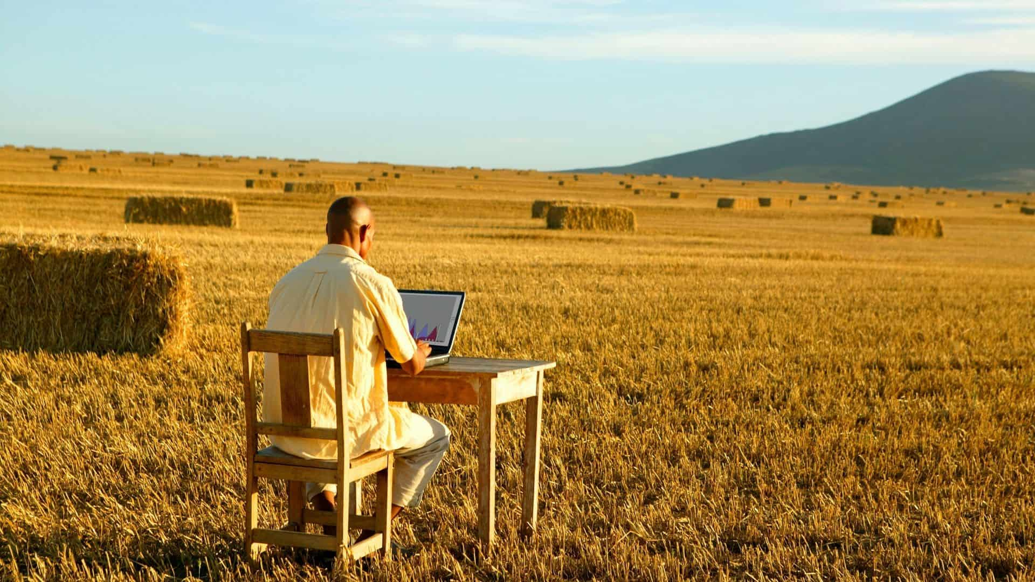
Sustainability & Partnerships
Solar Energy
Low-cost, eco-friendly power for hubs
Partners
Internet Providers – Data
PEP – Delivery
Absa/Yoco – Payments
Revenue Streams
Ads, premium courses, sponsorships

Slide 7
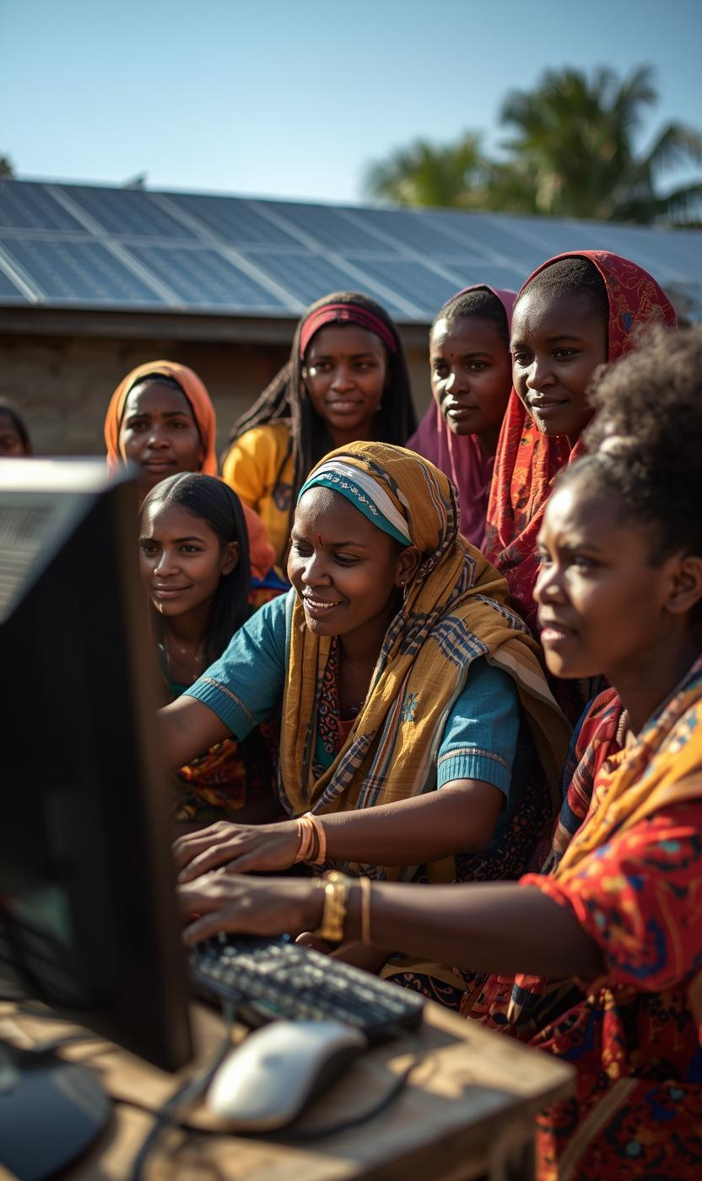
Impact
Empowered Women. Empowered Economies.
Who Benefits:
Rural women entrepreneurs gain digital skills, confidence, and income.
Communities gain new local tech hubs and Wi-Fi access.
Young girls see role models in business through tech.
South Africa gains progress toward SDGs (Gender Equality, Decent Work, Reduced Inequality).

Slide 8
On to the Protype
Siyakha

